Slide 1




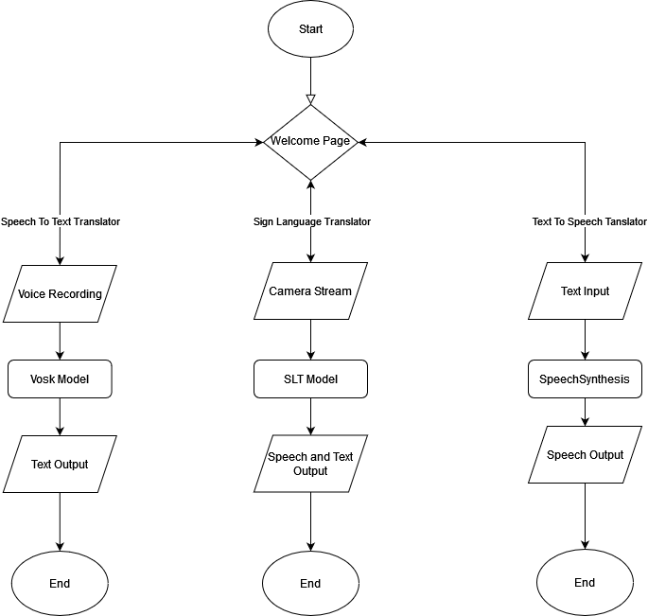
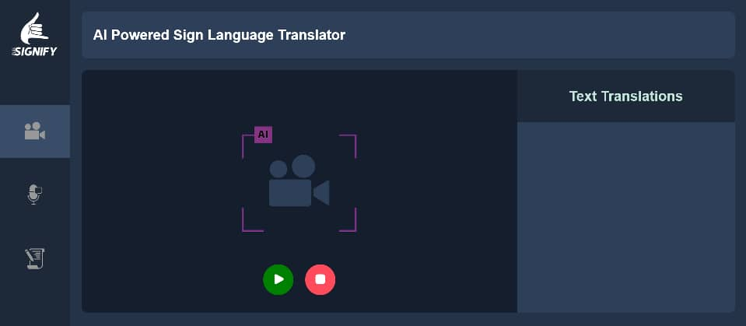
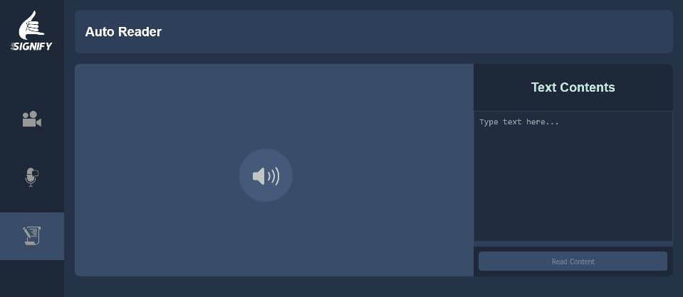
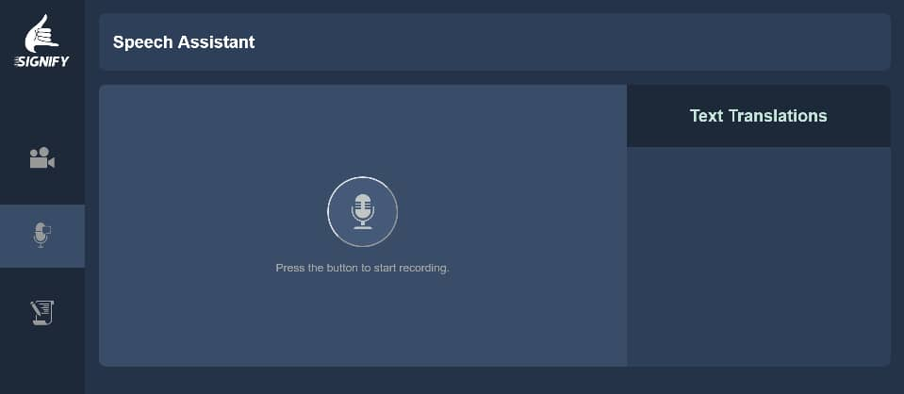
DESIGN AND DEVELOPMENT OF SIGN LANGUAGE INTERPRETATION SYSTEM WITH ENHANCED SPEECH AND TEXT CONVERSION
Department of Computer Engineering, Faculty of Engineering,
Ahmadu Bello University Zaria, Kaduna State, Nigeria
Student Name: Erasmus E Obeth Supervised by: Engr. R. F. Adebiyi
Abstract
This project addresses the communication barriers between the deaf and hearing-impaired by developing a software solution that integrates Sign Language Recognition (SLR) with Text-To-Speech (TTS) and Speech-To-Text (STT) capabilities. Utilizing advancements in Artificial Intelligence and Machine Learning, the system aims to facilitate real-time translation between sign language and spoken language. The project focuses on creating an accurate, accessible, and user-friendly tool to enhance communication and promote inclusivity for individuals with hearing impairments.
Introduction
Methodology
Results
This project is a software solution developed to bridge communication gaps between the speech and hearing impaired individuals with the non-impaired people of their communities. The integrated sign language recognition (SLR), text-to-speech (TTS) and speech-to-text (STT) technologies aims to provide real-time translation and enhance inclusivity while empowering individuals with these impairments.
The process for the implementation of the project is summarized in the flowchart below.
WELCOME PAGE
Innovation & Creativity
The developed system (signify) integrates sign language recognition (SLR) with text-to-speech (TTS) and speech-to-text (STT) technologies into a single platform. By employing advanced AI and machine learning, it enhances accuracy and adaptability. The user-friendly interface improves accessibility, reducing reliance on human interpreters and promoting greater independence for individuals with hearing impairments.
Potential for Product Commercialization
The developed system (signify) has strong commercialization potential by addressing accessibility needs in education, healthcare, and public services. Its integration of SLR, TTS, and STT technologies makes it valuable for institutions and businesses, enhancing communication and inclusivity. Its user-friendly design and innovative approach position it well for widespread adoption.
Conclusion
This project is a software solution that integrates sign language recognition with text-to-speech and speech-to-text technologies. It serves as an Augmentative and Alternative Communication (AAC) tool to help improve the lives of these impaired individuals using its real-time sign language translation, speech assistance, and auto text reading functionalities.
Future Work
Acknowledgement
References
Future enhancements could include multilingual support, contextual understanding, real-time video integration, customizable user profiles. Expanding integration with other technologies could also improve functionality.
our unreserved gratitude goes to God who is the giver of life and grace. We will also want to thank our supervisor and especially Dr. Ajayi who has worked tirelessly to substantiate this project. And to our parent, May God reward you in His mercies.
Hinton, G., Vinyals, O., & Dean, J. (2015). Distilling the knowledge in a neural network. arXiv preprint arXiv:1503.02531.
Yamagishi, J., & Latorre, J. (2019). Text-to-Speech Synthesis: A Review of Recent Advances. ACM Computing Surveys, 51(6), 1-40.

Slide 2
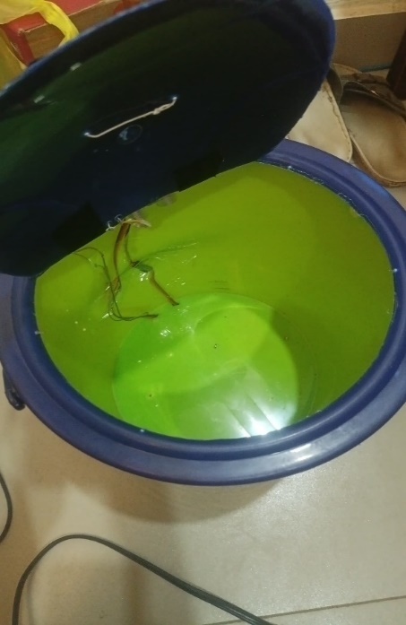
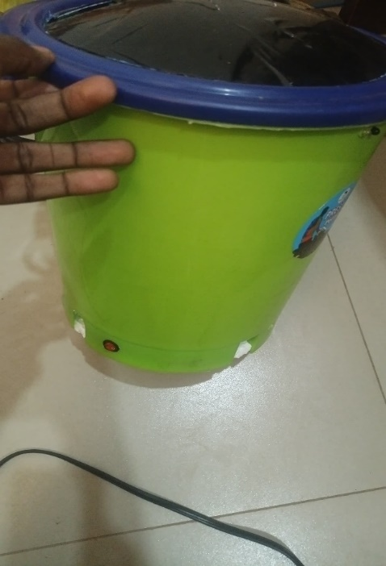
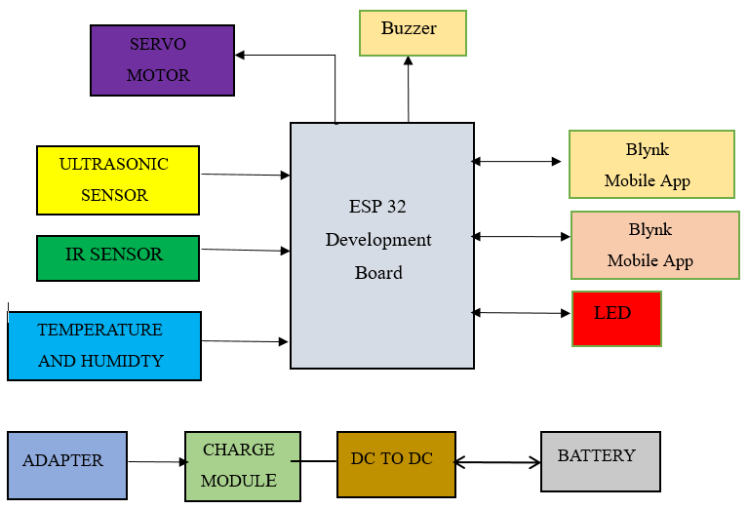
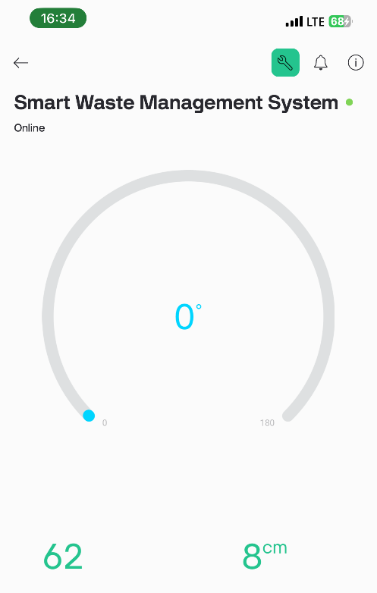
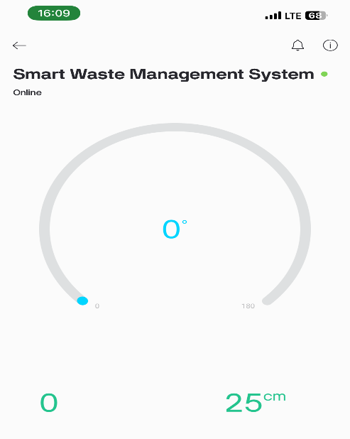
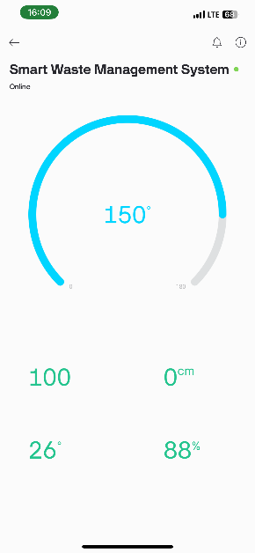
SMART GARBAGE MONITORING SYSTEM USING INTERNET OF THINGS (IOT)
Lawal Abdulwahab Olugbenga
Ajikanle Abdulbasit Abiola
Student Name: Supervised by: Dr. O. Ajayi
Department of Computer Engineering, Ahmadu Bello University Zaria, Nigeria
Abstract
This project details the development of a Smart Garbage Monitoring System utilizing IoT technology to enhance urban waste management. The system integrates an ESP32 microcontroller and ultrasonic sensors to provide real time monitoring of garbage levels, tackling issues such as inefficient waste collection and pollution. The system aims to provide real time waste level detection and automated notifications. The methodology describes the use of hardware components like the ESP32 board and ultrasonic sensor, detailing system design, programming, and testing procedures to ensure functionality. Result shows that the DHT22 sensor recorded an average temperature of 25.42°C and 65% humidity, with peaks in temperature at mid-day and increased humidity after rain. Ultrasonic sensors accurately measured bin fill levels, with empty bins at 25 cm, partially filled at 8 cm, and full at 0 cm. The system features a buzzer that alerts at 70% and 90% fill levels and operates for 20 hours on a 120- minute charge. The mobile app shows real-time data, and the system achieved 99.5% uptime over a week with no false alerts.
Introduction
Methodology
Results
Waste management has become a global issue due to rapid population growth, disorganized systems, lack of public awareness, and insufficient funds (Anitha, 2017). Uncontrolled garbage accumulation pollutes the environment and poses health hazards. Delayed garbage collection generates foul odors and toxic gases, contributing to air pollution. By monitoring bin status and garbage volume, waste management can be more efficient. The Internet of Things (IoT) enables communication between devices, allowing for timely notifications when bins are full. This system, as proposed by Anitha, will improve city cleanliness by notifying authorities to empty bins as needed.
The process for the implementation of the project is summarized below:
The developed prototype and results is shown in the figure below.
Innovation & Creativity
System Block Diagram
The innovation and creativity of the Smart Garbage Monitoring System lie in its use of IoT technology to address urban waste management challenges. By integrating the ESP32 microcontroller with ultrasonic sensors, the system offers real-time waste level monitoring and automated notifications, enhancing collection efficiency. This proactive approach addresses inefficiencies in waste management, contributing to urban cleanliness. The system’s ability to detect waste levels accurately and trigger alerts based on critical thresholds exemplifies its innovative alignment with modern smart city initiatives.
System Architecture
Potential for Product Commercialization
The Smart Garbage Monitoring System addresses the pressing need for efficient urban waste management by offering a cost-effective and scalable solution. Its use of the ESP32 microcontroller and ultrasonic sensors makes it viable for large-scale deployment. The system's real-time monitoring and automated notifications provide a unique technological solution that could attract interest from municipalities and waste management companies. Furthermore, its ability to integrate with existing infrastructure and customize according to user requirements enhances its commercial potential, making it a valuable tool for improving urban waste management practices.
Conclusion
The project successfully developed a smart garbage monitoring system using IoT technology, integrating an ESP32 microcontroller, ultrasonic sensors, and a mobile application to provide real-time monitoring of garbage levels. The system demonstrated its potential to improve garbage management practices by providing timely information and optimizing collection routes, though it faced limitations in battery life, environmental factors, scalability, and network dependency.
Future Work
Acknowledgement
References
Future work should focus on exploring alternative power sources like solar panels, implementing machine learning algorithms to enhance prediction accuracy, integrating additional sensors for comprehensive data, developing mesh network capabilities for better connectivity, conducting larger-scale trials, and integrating the system with existing municipal garbage management systems to maximize its impact and sustainability.
My most profound gratitude goes to ALLAH (SWT) the Almighty for giving me the strength, health, and ability to finish this project. My sincere appreciation goes to my supervisor Dr. O. Ajayi for his ceaseless support and encouragement throughout the course of this project. My Sincere thanks to the staffs of computer engineering.
Kim, J. (2023). Analysis and optimization of DC supply range for the ESP32 development board. Authorea Preprints.
Tarzamni, H., Kolahian, P., & Sabahi, M. (2020). High step-up DC–DC converter with efficient inductive utilization. IEEE Transactions on Industrial Electronics, 68(5), 3831-3839.
Arun Francis, G., Arulselvan, M., Elangkumaran, P., Keerthivarman, S., & Vijaya Kumar, J. (2020). Object detection using ultrasonic sensor. Int. J. Innov. Technol. Explor. Eng, 8, 207-209.

Slide 3
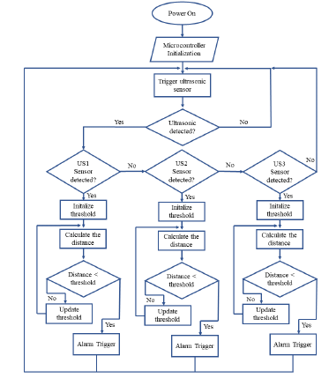
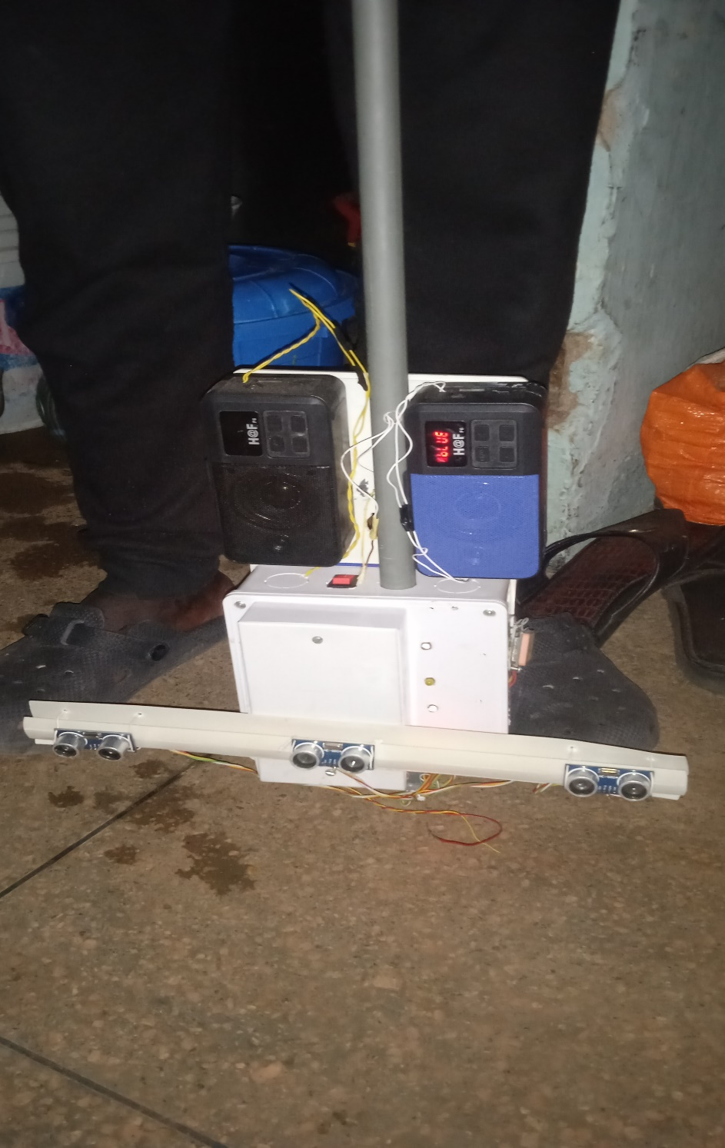
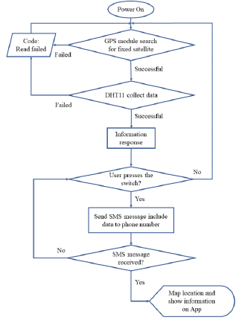
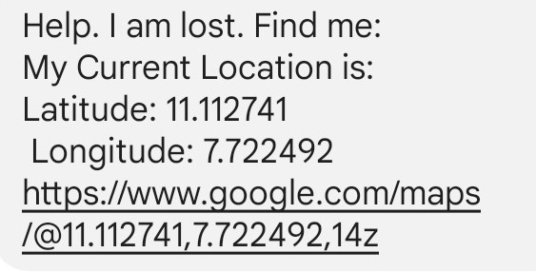
SMART WALKING STICK WITH EMERGENCY DISTRESS BUTTON
Student Name: Nuhu Surajo Umar Supervised by: Dr. O. Ajayi
Department of Computer Engineering, Ahmadu Bello University Zaria, Nigeria
Abstract
The smart walking stick with emergency distress button for visually impaired individuals aims to provide a valuable assistive device to enhance mobility and safety in navigating their surroundings. The prototype integrates Arduino, ultrasonic sensors, a sound system, GPS module, and GSM module to create a comprehensive and intuitive solution. The ultrasonic sensors detect nearby obstacles and hazards, providing real-time feedback through sound alerts to aid users in avoiding potential obstacles. The GPS module offers precise location information and in case of emergencies, the GSM module allows users to send quick distress messages to designated caregivers, including their current location in form of URL. Throughout testing, the smart walking stick demonstrated promising results in aiding visually impaired individuals to navigate independently and confidently.
Introduction
Methodology
Results
The eyes are the most important sense of organ of human. We perceive up to 80 percent of all impressions by means of our sight. Visual impairment, also known as vision impairment, is a medical definition primarily measured based on an individual's better eye visual acuity, in the absence of treatment such as correctable eyewear, assistive devices, and medical treatment visual impairment may cause the individual difficulties with normal daily tasks including reading and walking (Wikipedia, 2023).
Due to the vision disability, obstacles, which is sometimes annoyed the visually impaired people, become a huge problem. An investigation for Nonvisual Navigation shows that the blind preferred to have the detail of the direction and travel independently therefore the used of human and dogs is less suitable (Kumar, 2020).
The process for the implementation of the project is summarized in a flowchart for object detection and location tracker in the figure below:
The developed prototype and results is shown in the figure below.
Innovation & Creativity
System Block Diagram
The innovation and creativity of the smart walking stick project lie in its multifaceted approach to addressing the unique challenges faced by visually impaired individuals. By seamlessly integrating ultrasonic sensors, GPS navigation, GSM communication, and sound feedback systems, this device offers a comprehensive solution that enhances mobility, safety, and independence. Its user-centric design, real-time obstacle detection, and the ability to provide turn-by-turn directions and emergency communication exemplify its innovative and creative solutions.
Potential for Product Commercialization
The project addresses the pressing need to enhance the mobility and safety of visually impaired individuals, offering a unique technological solution that combines advanced features into a single device. It also empowers visually impaired individuals by offering them greater independence in their daily lives there by making it an essential tool needed for the day to-to day activities of visually impaired persons. Furthermore, ability to add more component and customize according to user requirement would prove essential for commercialisation.
System Flowchart
Conclusion
In conclusion, the smart walking stick prototype was successful in providing an added level of safety and independence to visually impaired individuals. The integration of the components worked well together to create a reliable tool for navigating one's environment. the system proved to be a useful tool for visually impaired individuals and has the potential to be further developed and improved to meet their needs.
Future Work
Acknowledgement
References
Integration of additional sensors, such as cameras to detect a wider range of obstacles.
Use of alternative communication methods, such as Wi-Fi or Bluetooth, to improve the reliability of emergency messaging in areas with poor GSM connectivity.
Implementation of machine learning algorithms to improve the accuracy of obstacle detection and classification.
My most profound gratitude goes to ALLAH (SWT) the Almighty for giving me the strength, health, and ability to finish this project. My sincere appreciation goes to my supervisor Dr. O. Ajayi for his ceaseless support and encouragement throughout the course of this project. My Sincere thanks to the staffs of computer engineering.
Kumar, A., Patra, R., Manjunatha, M., Mukhopadhyay, J., & Majumdar, A. K. (2014). An electronic travel aid for navigation of visually impaired persons. In 2014 3rd International Conference on Communication Systems and Networks, COMSNETS 2014. https://doi.org/10.1109/COMSNETS.2011.5716517
Wikipedia. (2022). Eyes. Retrieved from https://en.wikipedia.org/wiki/Eye
.

Slide 4
SMART GARBAGE MONITORING SYSTEM USING INTERNET OF THINGS (IOT)
Lawal Abdulwahab Olugbenga
Ajikanle Abdulbasit Abiola
Abstract
3D Insights introduces a prototype Learning Management System (LMS) that integrates interactive 3D model interaction to enhance student comprehension of complex course content, particularly in STEM education. Traditional educational methods often struggle to effectively convey spatial or visual concepts, leading to reduced comprehension and retention among learners. By leveraging 3D models within the LMS, students can interact with and visualize complex concepts, improving comprehension, engagement, and retention. A prototype of the LMS was developed and the capability to upload 3D models in various export format and interact with them are integrated into the platform. This prototype demonstrates the potential of 3D-enhanced LMS platforms to revolutionize STEM education, providing a more engaging, accessible, and effective learning experience for students.
Introduction
Methodology
Results
Today’s education, especially in STEM (Science, Technology, Engineering, and Mathematics) fields, often struggles with traditional methods that use only text and 2D images. These methods can make it hard for students to understand complex concepts, leading to lower comprehension and retention (Smith et al., 2020). Our project aims to improve this by creating a Learning Management System (LMS) that includes interactive 3D models. This new approach allows students to interact with and explore 3D models directly in the LMS, making learning more engaging and effective (Wenzel & Moreno, 2022). By integrating these 3D models, we hope to make STEM subjects easier to understand and more exciting for students (Holland et al., 2020)..
The process for the implementation of the project is summarized below:
The developed prototype and results is shown in the figure below.
Innovation & Creativity
System Block Diagram
The innovation and creativity of the Smart Garbage Monitoring System lie in its use of IoT technology to address urban waste management challenges. By integrating the ESP32 microcontroller with ultrasonic sensors, the system offers real-time waste level monitoring and automated notifications, enhancing collection efficiency. This proactive approach addresses inefficiencies in waste management, contributing to urban cleanliness. The system’s ability to detect waste levels accurately and trigger alerts based on critical thresholds exemplifies its innovative alignment with modern smart city initiatives.
System Architecture
Potential for Product Commercialization
The Smart Garbage Monitoring System addresses the pressing need for efficient urban waste management by offering a cost-effective and scalable solution. Its use of the ESP32 microcontroller and ultrasonic sensors makes it viable for large-scale deployment. The system's real-time monitoring and automated notifications provide a unique technological solution that could attract interest from municipalities and waste management companies. Furthermore, its ability to integrate with existing infrastructure and customize according to user requirements enhances its commercial potential, making it a valuable tool for improving urban waste management practices.
Conclusion
The LMS prototype with integrated 3D model interaction effectively demonstrated its ability to enhance student engagement and comprehension in STEM subjects. By addressing the challenges of passive learning and the difficulty in understanding complex concepts, the system provided an interactive and immersive educational experience. The project successfully showed that this approach can make STEM education more accessible and impactful. Ongoing improvements and research will continue to build on these findings to further enhance the prototype’s educational value.
Future Work
Acknowledgement
References
Future work should focus on exploring alternative power sources like solar panels, implementing machine learning algorithms to enhance prediction accuracy, integrating additional sensors for comprehensive data, developing mesh network capabilities for better connectivity, conducting larger-scale trials, and integrating the system with existing municipal garbage management systems to maximize its impact and sustainability.
My most profound gratitude goes to ALLAH (SWT) the Almighty for giving me the strength, health, and ability to finish this project. My sincere appreciation goes to my supervisor Dr. O. Ajayi for his ceaseless support and encouragement throughout the course of this project. My Sincere thanks to the staffs of computer engineering.
Smith, D. W., Lampley, S. A., Dolan, B., Williams, G., Schleppenbach, D., & Blair, M. (2020). Effect of 3D manipulatives on students with visual impairments who are learning chemistry constructs: a pilot study. Journal of Visual Impairment & Blindness, 114(5), 370-381.Wenzel, A., & Moreno, J. (2022). Designing and facilitating optimal LMS student learning experiences: Considering students' needs for accessibility, navigability, personalization, and relevance in their online courses. The Northwest eLearning Journal, 2(1).Holland, J. L., Lee, S., Daouk, M., & Agbaji, D. A. (2020). Higher education teaching and learning with augmented reality. In Handbook of Research on Fostering Student Engagement with Instructional Technology in Higher Education (pp. 229-248). IGI Global.

Slide 5


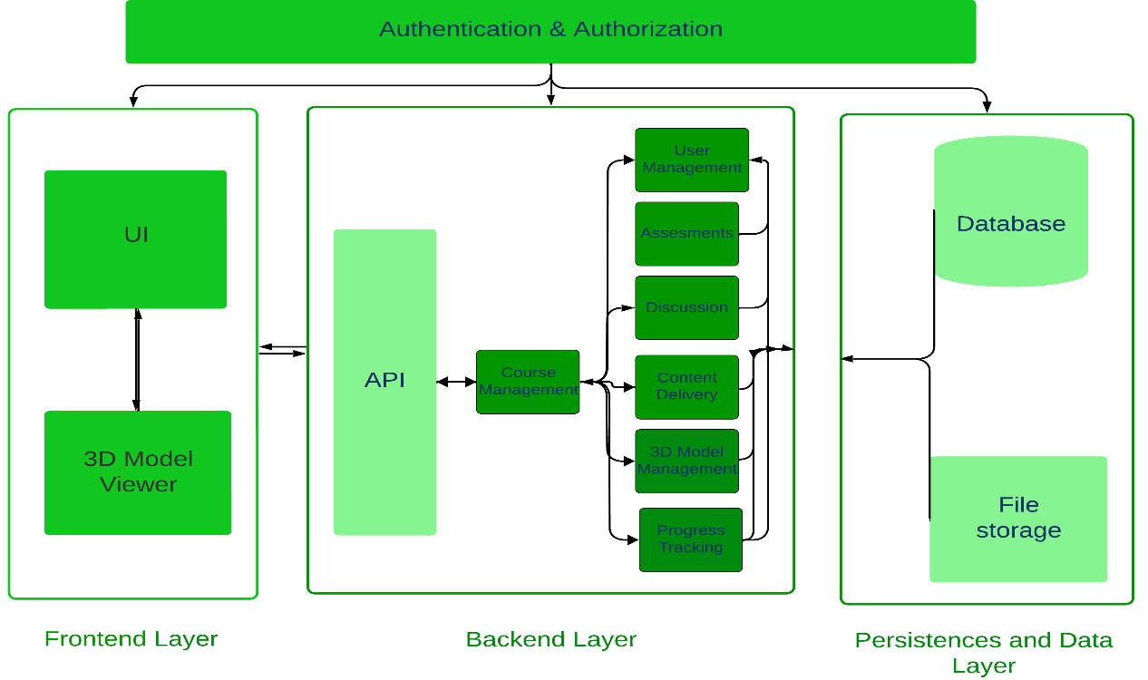
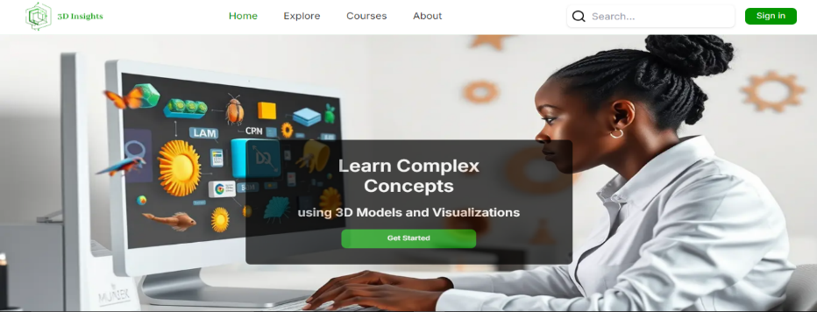
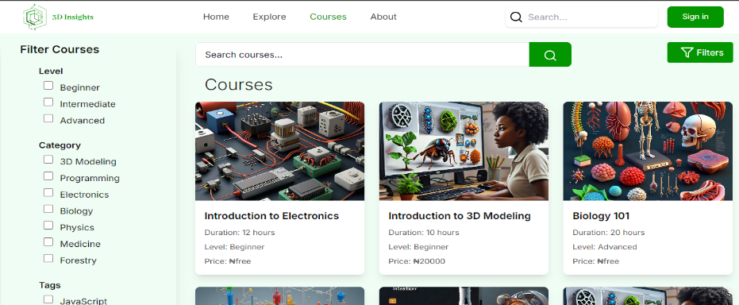
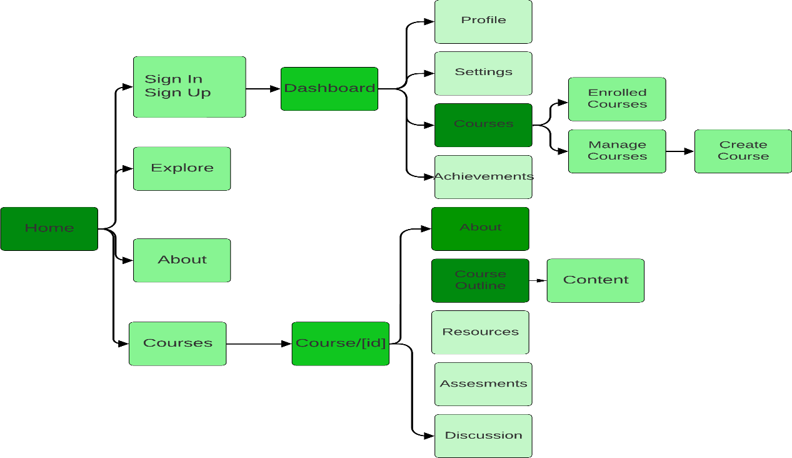
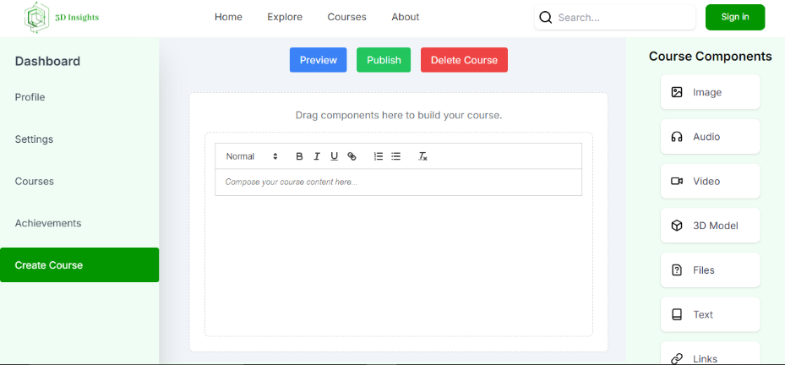
DEVELOPMENT OF A LEARNING MANAGEMENT SYSTEM (LMS) WITH INTEGRATED 3D MODEL INTERACTION
Department of Computer Engineering, Faculty of Engineering,
Ahmadu Bello University Zaria, Kaduna State, Nigeria
Student Name: Erasmus E Obeth Supervised by: Engr. R. F. Adebiyi
Abstract
3D Insights introduces a prototype Learning Management System (LMS) that integrates interactive 3D model interaction to enhance student comprehension of complex course content, particularly in STEM education. Traditional educational methods often struggle to effectively convey spatial or visual concepts, leading to reduced comprehension and retention among learners. By leveraging 3D models within the LMS, students can interact with and visualize complex concepts, improving comprehension, engagement, and retention. A prototype of the LMS was developed and the capability to upload 3D models in various export format and interact with them are integrated into the platform. This prototype demonstrates the potential of 3D-enhanced LMS platforms to revolutionize STEM education, providing a more engaging, accessible, and effective learning experience for students.
Introduction
Methodology
Result
Z
Today’s education, especially in STEM (Science, Technology, Engineering, and Mathematics) fields, often struggles with traditional methods that use only text and 2D images. These methods can make it hard for students to understand complex concepts, leading to lower comprehension and retention (Smith et al., 2020). 3D Insights aims to improve this by creating a Learning Management System (LMS) that includes interactive 3D models. This new approach allows students to interact with and explore 3D models directly in the LMS, making learning more engaging and effective (Wenzel & Moreno, 2022). By integrating these 3D models, we hope to make STEM subjects easier to understand and more exciting for students.
The process for the implementation of the project is summarized below:
Some of the developed prototype Screens and results are shown in the figures below.
System Architecture
User Flow
Potential for Product Commercialization
The prototype has strong commercialization potential as it addresses a critical need in STEM education. Its innovative use of 3D models could attract educational institutions seeking advanced learning solutions. Further development could lead to partnerships with educational technology providers and integration into existing LMS platforms.
Innovation and Creativity
3D Insights introduces an innovative approach to Learning Management Systems (LMS) by integrating interactive 3D model technology using WebGL and Three.js. This novel method enhances traditional LMS platforms, offering a dynamic educational tool that overcomes the limitations of text-based and 2D visual methods of representing learning materials and also provides a new, more engaging dimension to learning.
Conclusion
The LMS prototype 3D Insights with integrated 3D model interaction effectively demonstrated its ability to enhance student engagement and comprehension in STEM subjects. By addressing the challenges of passive learning and the difficulty in understanding complex concepts, the system provided an interactive and immersive educational experience. The project successfully showed that this approach can make STEM education more accessible and impactful. Ongoing improvements and research will continue to build on these findings to further enhance the prototype’s educational value.
References
Smith, D. W., Lampley, S. A., Dolan, B., Williams, G., Schleppenbach, D., & Blair, M. (2020). Effect of 3D manipulatives on students with visual impairments who are learning chemistry constructs: a pilot study. Journal of Visual Impairment & Blindness, 114(5), 370-381.
Wenzel, A., & Moreno, J. (2022). Designing and facilitating optimal LMS student learning experiences: Considering students' needs for accessibility, navigability, personalization, and relevance in their online courses. The Northwest eLearning Journal, 2(1).
Acknowledgement
Future Work
I thank Engr. Risikat. F. Adebiyi for her guidance and support throughout the development of 3D Insight LMS., that were instrumental in bringing this project to fruition. I am also deeply appreciative of my family and friends for their unwavering support, dedication and encouragement throughout the endeavor.to the project's success.
Future work may involve support for AR, VR for immersive learning, gamification to boost engagement, and AI-driven recommendations for personalize learning. Continues Continuous Research and collaborations with educational institutions will be vital for refining and expanding these innovations and their implementation.

